Slide 1
You work for Astra Pharma, a leading pharmaceutical company that specializes in innovative medical solutions. Astra Pharma is planning a digital transformation initiative to improve the delivery and effectiveness of its medical products, including dapagliflozin, saxagliptin, saphnello, qtern, and epanova.
The company has been facing challenges in providing a seamless experience for healthcare professionals and patients across various touchpoints. Doctors, pharmacists, and patients often struggle to find trustworthy information about these products or complete necessary tasks independently.
As a result, there has been a surge in inquiries to Astra Pharma’s medical information hotline, increasing operational costs, prolonging response times, and diminishing overall satisfaction.
To address these issues, Astra Pharma is exploring the use of AI and automation technologies that can revolutionize its customer and healthcare provider support. The goal is to deliver high-quality, personalized experiences that align with the demands of modern healthcare professionals and patients, who expect convenient, self-service capabilities similar to those offered by cutting-edge AI solutions.
Pharmacists often need quick reference information while dealing directly with patients regarding medication regimens/dosages & potential side effects.
An automated tool such Watson x orchestrator equipped with knowledge graph providing relevant info at point of care might greatly benefit them. Such innovation aims not only streamline internal operations but also enhance patient care through improved accessibility accurate guidance.
IBM Watsonx Orchestrate has been identified as the ideal solution to tackle these challenges. Astra Pharma plans to use Watsonx Orchestrate Assistant Builder to develop AI-powered virtual assistants capable of providing fast, accurate, and 24/7 support across all digital platforms.
These virtual assistants will answer questions about Astra Pharma’s products such as dapagliflozin for managing diabetes or saphnello for treating lupus and guide healthcare providers and patients through common workflows, like ordering samples or accessing product safety information.

Slide 2
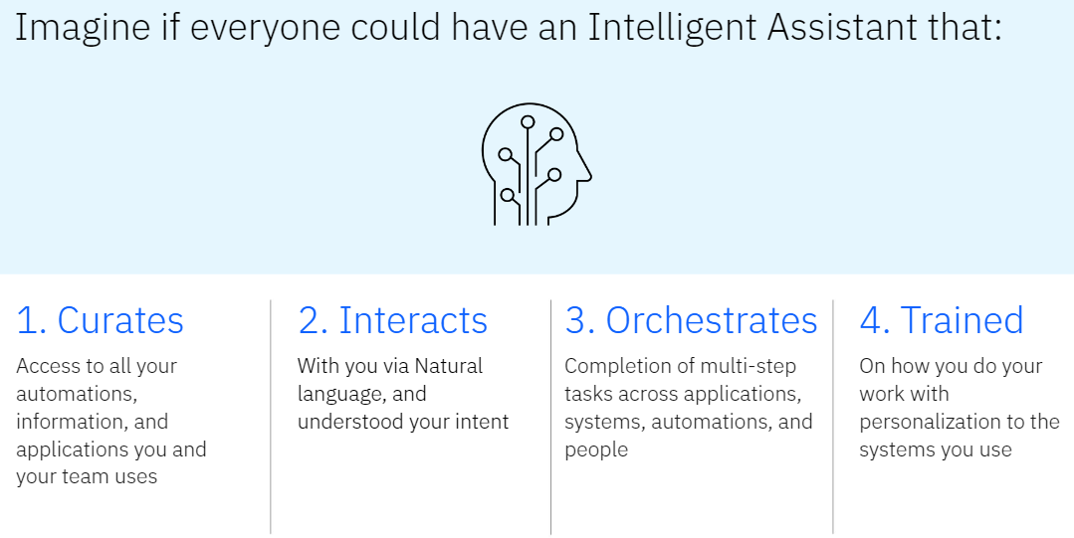

Slide 3
Your role is that you work in customer service and medical information at Astra Pharma, where you have a deep understanding of the needs of healthcare professionals and patients.
Although you don't have a background in software development, you’ve been assigned to lead the creation of Astra Pharma’s first AI assistant using Watsonx Orchestrate.
After the assistant is built, you will be responsible for monitoring its performance and continuously optimizing its responses.
You begin by gathering key data from Astra Pharma’s customer support logs, identifying the most frequently asked questions about products like qtern (for type 2 diabetes management) or epanova (for lowering triglycerides).
Your objective is to automate responses to these common inquiries and streamline workflows such as prescribing guidance or patient support programs.
As the project advances, you collaborate with cross-functional teams to design an efficient, conversational flow that ensures optimal user experience. Once the design phase is completed, you proceed to build actionable workflows within the Watsonx Orchestrate Assistant Builder, tailoring responses to the unique requirements of healthcare professionals, pharmacists, and patients.
This project is Astra Pharma’s first step toward enhancing customer engagement through digital innovation. You aim to quickly launch the assistant on Astra Pharma’s website, starting with product inquiries for saphnello and dapagliflozin, and scale up to support more complex interactions as you gather insights from real-time data.
Finite list of questions with static answers in a particular domain is a characteristic of a question and answer (Q&A) chatbot.

Slide 4
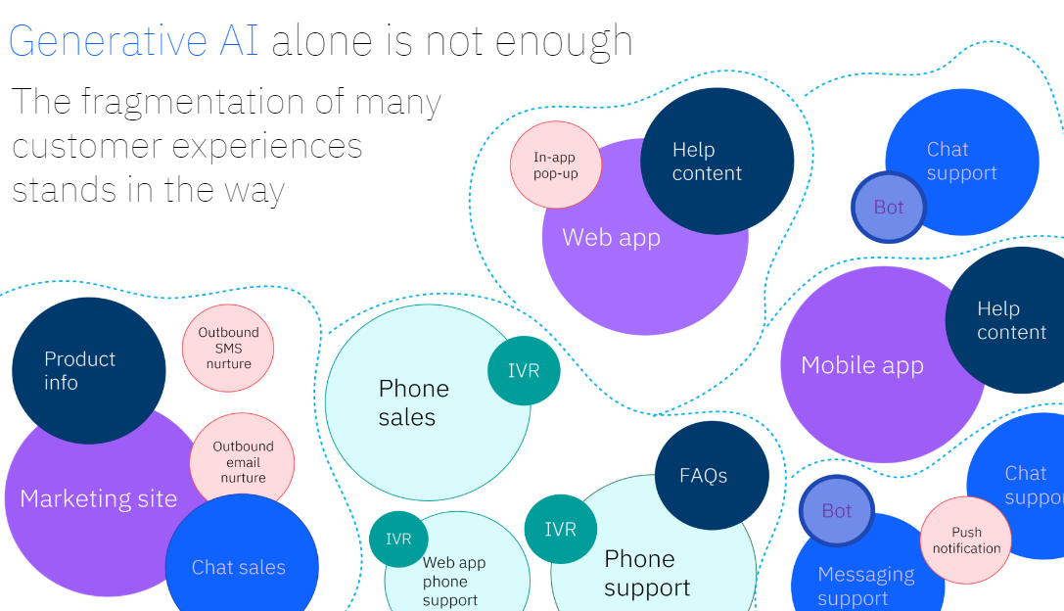

Slide 5
Course scenario in this course is that you will learn how to use Watsonx Orchestrate Assistant Builder to create AI assistants for Astra Pharma. By the end of this training, you will have mastered the following skills:
Designing conversational workflows using flowcharts.
Building basic and advanced actions tailored to healthcare provider and patient needs.
Ensuring that actions can be easily maintained and scaled.
Throughout the course, you will apply these best practices to create an AI assistant capable of addressing common queries and improving Astra Pharma’s overall customer experience.
Pharmaceutical Use Case Requirements
To build effective conversations for your AI assistant, gather all necessary documentation related to the medical products and treatments you wish to address.
This process helps you identify the most important use cases for patient and healthcare provider support, such as queries about omega-3-carboxylic acids (as found in epanova), roflumilast (branded as daliresp), and quetiapine (marketed as seroquel).

Slide 6
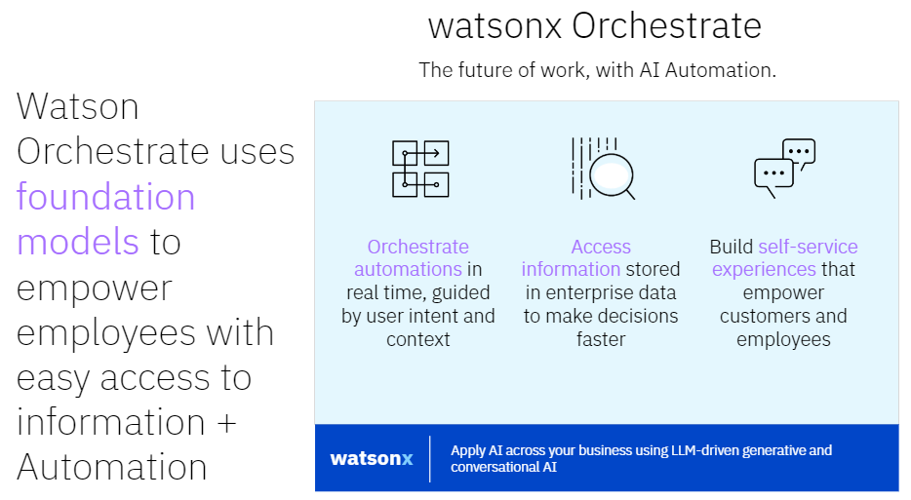

Slide 7
Flowchart Design
Utilize the gathered documentation and use cases to create a flowchart. This flowchart will help you visualize the conversation between the AI assistant and users, and begin designing the actions. You can use any flowchart design tool to accomplish this, ensuring the user journey is clear and aligned with best practices in the pharmaceutical field, such as providing accurate dosing or side effect information for epanova or daliresp.
The purpose of a flowchart is to keep track of all possible paths through the conversation.
Tips for Flowchart Design:
Include version history and detailed notes in the flowchart to track updates, such as regulatory changes or new drug releases.
Review multiple use cases for subactions, like addressing drug interactions or side effects, and mark global response candidates that apply across multiple product lines.
Base your flowchart design on real patient data and feedback, especially for critical conditions like chronic obstructive pulmonary disease (COPD) managed with daliresp or bipolar disorder managed with seroquel.

Slide 8
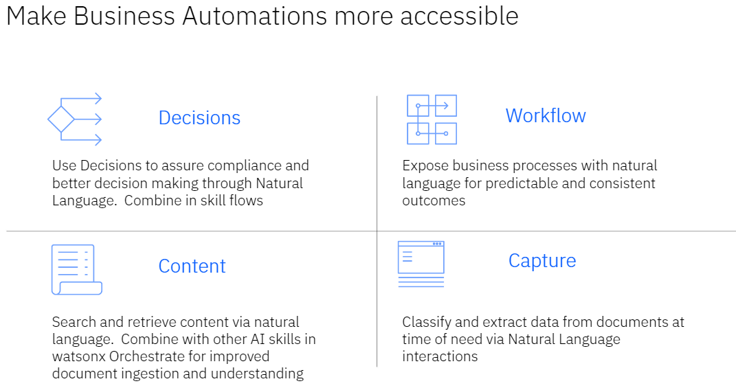

Slide 9
Action Design
The goal of action design is to create steps that are easy to maintain and scale, especially as new drugs, formulations, and treatments are introduced to the market.
Testing
Thoroughly test your actions and conversational flow to ensure everything functions smoothly. Ensure that the AI assistant can handle complex inquiries, such as those regarding the specific pharmacokinetics of roflumilast or the patient support programs for epanova.
Building an AI Assistant
Now that you understand the preparation process, you're ready to create a new action. An action in the pharmaceutical domain might help answer patient or provider questions, such as proper dosing for seroquel or the cholesterol-lowering effects of omega-3-carboxylic acids in epanova. Each action consists of four key parts:
1. Example Phrases (User Utterances):
Train the Watsonx Orchestrate Assistant Builder with sample phrases that patients or providers might use, such as, “What are the side effects of quetiapine?” or “How does epanova compare to other omega-3 treatments?” These utterances will help the natural language processing (NLP) model recognize intents.
The following are recommended for good training user utterances
Use real world examples
10-20 examples optimum
Should be varied in structure and words used

Slide 10
2.Specifying End-of-Step Actions
At the end of each step, decide where the conversation should go. For instance:
Continue to Next Step: The assistant may move on to discuss potential side effects of roflumilast if the patient confirms they are experiencing shortness of breath.
Re-ask Previous Step(s): If a patient provides unclear information, such as an incorrect dosage of epanova, the assistant may prompt them to re-enter the correct information.
Go to Subaction: For a more complex scenario, such as discussing both seroquel’s uses for schizophrenia and bipolar disorder, you can switch between subactions to provide tailored information.
End the Action: If the patient’s inquiry is fully addressed (e.g., they confirm they understand how to take daliresp), the action can conclude, resetting any variable values in preparation for the next inquiry.

Slide 11
3.Conditions in Action Steps
In a pharmaceutical context, actions must adapt to various patient scenarios. For example, the steps for discussing seroquel might differ based on whether the patient is asking about it for treating depression or schizophrenia.
Conditions allow you to tailor these steps based on the patient's input, making the conversation personalized and responsive to their needs.
By organizing actions into clear steps and incorporating conditions, your AI assistant can effectively manage inquiries about AstraZeneca products like epanova, daliresp, and seroquel, ensuring that both patients and healthcare providers receive accurate, timely information.
4. Use of Step Conditions in AI Assistant
In the pharmaceutical domain, step conditions allow you to create various pathways through an action based on real-time inputs from healthcare professionals or patients.
These conditions help determine how the interaction proceeds, guiding patients or providers through personalized, product-specific information.
Conditions are created using two operands and a Boolean operator, such as ==, <, >, <=, >=, or specific checks like "is before" or "is not."
This ensures that the user receives relevant, timely information about products like rosuvastatin (marketed as Crestor) or acalabrutinib (sold as Calquence).

Slide 12
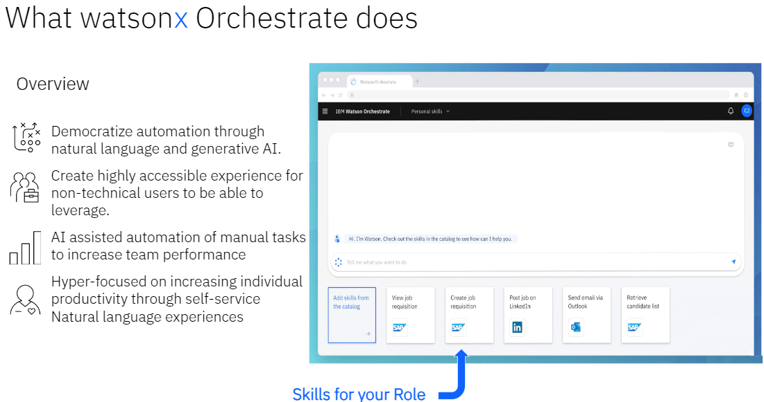

Slide 13
Example use cases
Condition to Personalize Greetings
Imagine a patient or healthcare provider begins an interaction with the assistant by providing identification. If they do, the assistant could respond: "Hello, Dr. Smith!
How can I assist you with Crestor today?" If they fail to identify themselves, the assistant might say, "Unfortunately, I was unable to recognize your credentials."
Condition to Validate Inputs
For example, if a healthcare provider is walking through a “Schedule a follow-up” action to book a patient’s next appointment for monitoring their acalabrutinib treatment, the assistant ensures the date entered is within the next 30 days.
Any date before today or more than 30 days from now is invalid and triggers an appropriate prompt for correction.
Assistant Responses
In each step, the Assistant says section dictates how the AI assistant communicates with the user, whether by providing direct answers or requesting further information.
For instance, the assistant may explain dosage guidelines for Crestor or provide safety warnings for Calquence.
Responses can be simple text, formatted content, or references to previously input information (e.g., dosage amounts or patient symptoms) stored as variables during the conversation. These variables allow the assistant to personalize interactions and adjust its responses in real-time.

Slide 14
Example of BMFM technologies
IBM Research's biomedical foundation model (BMFM) technologies utilize a wide range of medical data types, similar to how medications like aspirin or insulin are used in treating conditions like fever or diabetes.
These models analyze data such as small molecules that resemble drug compounds and proteins similar to how enalapril affects blood pressure and cover a massive collection of over a billion molecules, along with important biological data like RNA sequences from single cells.
IBM research team includes experts from various fields, like pharmacology and biochemistry, similar to how different specialists come together to treat complex medical conditions.
The foundation models for identifying new treatment targets work by analyzing DNA, RNA, and other cellular signals to discover potential diagnostic and therapeutic interventions.
This is comparable to how medications like aspirin are developed based on understanding their impact on inflammation and fever.
These models help with tasks such as identifying cell types, predicting how genes might be affected by certain treatments, understanding disease progression, and predicting how patients might respond to treatments similar to how we predict a diabetic patient's response to insulin. It is similar to how Watsonx orchestrate automates repetitive tasks which are often cumbersome for doctors
IBM Research's biomedical foundation model (BMFM) technologies function like the way aspirin works with regard to insulin for managing diabetes. These technologies analyze various medical data, including drug-like small molecules and proteins, similar to how we study the effects of enalapril for hypertension or antibiotics for infections.
The data spans over a billion molecules and includes essential biomedical information like single-cell RNA sequences, which are crucial for understanding diseases, much like how we track blood sugar levels in diabetes or monitor inflammation in cases of fever.
IBM research team consists of specialists in fields such as medicinal chemistry and biomedical informatics, similar to how pharmacists, doctors, and researchers work together to treat conditions like fever or hypertension. These foundation models, especially for Targets Discovery, are like tools for discovering new therapeutic options, akin to finding a new antibiotic for an infection.
They focus on studying DNA, RNA, and other cell-level signals to identify new diagnostic and treatment targets, just as we study the effects of aspirin on inflammation or insulin on glucose levels. The models support tasks like identifying different cell types, predicting how genes might respond to treatments, forecasting disease progression, and determining how patients might respond to various therapies, similar to predicting how someone with diabetes might react to insulin therapy.

Slide 15
IBM Research's biomedical foundation model (BMFM) technologies utilize a wide range of medical data types, similar to how medications like aspirin or insulin are used in treating conditions like fever or diabetes.
Biological discovery models in pharmaceuticals work similarly to how doxycycline targets Plasmodium in malaria treatment or how bronchodilators relieve airway constriction in respiratory conditions. These models are designed to explore biologic therapeutics, focusing on proteins much like how angiotensin plays a role in blood pressure regulation or how vasodilation improves blood flow in cardiovascular therapies.
The goal is to utilize vast representations of protein sequences, structures, and their behaviors, similar to understanding how antibiotics like doxycycline affect bacterial proteins in malaria. These models create unified representations of biological molecules by integrating data like protein sequences, the structures of protein complexes, and the binding free energies between proteins, similar to how TCRs (T-cell receptors) recognize and bind to antigens in immune response.
These biologics discovery models enable various downstream applications in therapeutic design, much like how vaccines are developed for disease prevention or antibodies are engineered to target specific pathogens. They can help in generating and assessing therapeutic candidates for antibodies, TCR therapies, vaccines, and other biologic treatments, ensuring more effective and precise medical interventions.
Small molecule models in pharmaceuticals function like how ibuprofen relieves bronchitis symptoms or how lisinopril manages blood pressure by targeting the adrenal gland. These models are designed to handle various predictive and generative tasks, similar to predicting how a bronchodilator can alleviate breathing difficulties or how a specific drug might interact with a biological system.
The models are trained on multiple representations of small molecules, much like how ibuprofen has been studied for its anti-inflammatory properties or how erythrism affects certain biochemical processes.
By analyzing these small molecules, the models help with tasks like predicting drug properties, affinities (similar to understanding how ibuprofen reduces pain or lisinopril lowers blood pressure), and even generating new molecules based on known templates, similar to modifying drug compounds to improve efficacy. Predictive models, like those for bronchodilators in respiratory conditions, are trained on multiple perspectives of small molecule data and learn valuable representations by understanding how different views of a molecule relate to each other.
Generative models such as Watsonx orchestrate, much like designing a new bronchodilator for bronchitis treatment, work by altering input molecules to create new versions with improved properties through diffusive processes, similar to how a bronchodilator might be enhanced for better airway response. Given a set of desired characteristics and a template molecule (such as the 3D structure of lisinopril), the model can produce a set of newly designed molecules with the desired therapeutic effects.

Slide 16
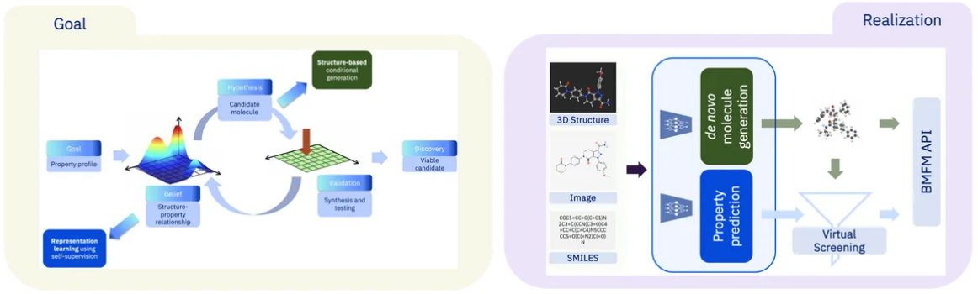
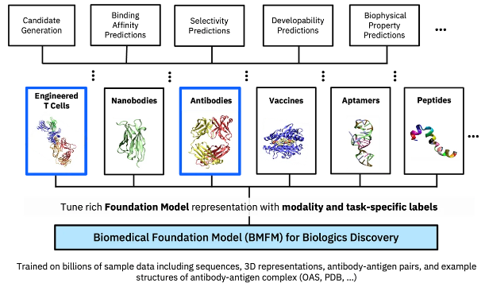

Slide 17
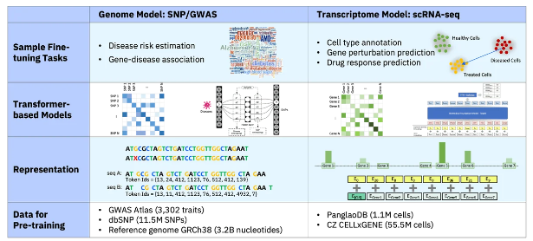
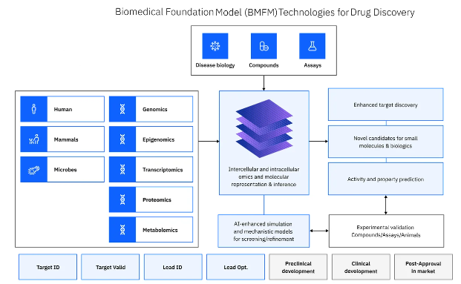

Slide 18
Tips for Crafting Responses:
Keep answers concise and focused on critical information, such as dosage adjustments for rosuvastatin or potential side effects of acalabrutinib.
Reflect the user's intent to ensure the virtual assistant correctly understands and responds. For example, if a healthcare provider asks, "What are the contraindications of Calquence?" the assistant can provide a list of conditions and medications that could interact with it.
Include links to external sources, such as clinical studies or prescribing guidelines, if the information depends on frequently changing data, such as drug recalls or updated FDA approvals.
Carefully word responses to guide the user through medical decision-making, such as adjusting treatment plans or determining the best time to administer Crestor.
In addition to text, responses can incorporate multimedia elements like images, videos, or interactive iframes that explain complex mechanisms of action for drugs like acalabrutinib.
The Change conversation topic feature enables your assistant to handle digressions dynamically responding to a user by changing the conversation topic as needed
With ask clarifying questions, watsonx Orchestrate can automatically switch to a different topic.
To deploy an assistant, which is a Question & Answer (Q&A) chatbot to a website, the steps below need to be taken;
Open your production html, copy the <script> . . . </script> code from the live environment, paste it between the <head></head> tags in your html file.
The reason why you would want to use different environments in watsonx Orchestrate's Assistant Builder is so as to keep development separate from end users

Slide 19
Defining Customer Responses
When designing an assistant for healthcare or pharmaceutical use, you must clearly specify what type of response is expected.
Whether asking a provider to input a date for a follow-up or having a patient confirm if they’ve taken their rosuvastatin dose, the assistant uses predefined response types to ensure accuracy and consistency.
Response Types and Use Cases:
Number, currency, date, time, percentage: When asking for specific patient data, such as the dosage of Crestor or the date of their next lab test, the assistant validates input to ensure it’s correct and interpretable.
Options and confirmation: Offer predefined options, such as “Yes” or “No,” when confirming side effects of acalabrutinib or choosing between treatment plans.
Free text: Patients might provide free-text descriptions of their symptoms or complaints, which the assistant can process to suggest medication adjustments or connect them to a healthcare provider.
Regex for structured data: Use regular expressions to validate information such as an email address when enrolling patients in a Crestor patient support program or capturing phone numbers for scheduling follow-ups.

Slide 20
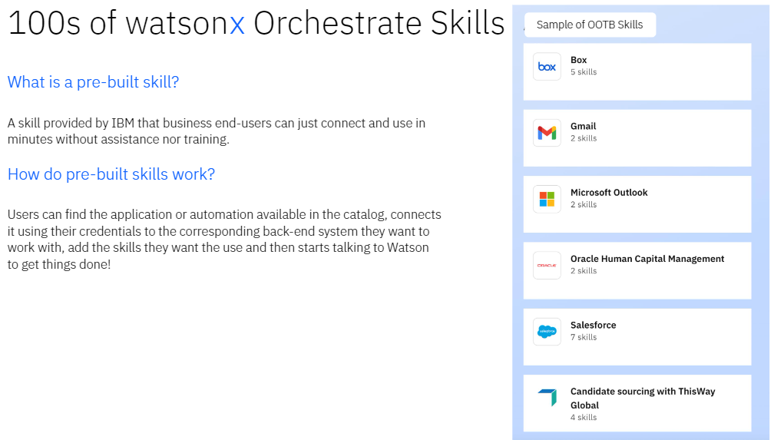

Slide 21
Managing Conversation Paths with Variables
As patients or providers share information such as current medication, dosage, or treatment progress the assistant stores this data as variables.
For example, after noting that a patient is on a high dose of Crestor, the assistant can use this information later to provide specific dietary recommendations or precautions about side effects.
By utilizing these tools and designing robust conditions, the AI assistant can effectively guide healthcare professionals and patients through inquiries about Crestor, Calquence, and other AstraZeneca products, ensuring a tailored, efficient user experience.

Slide 22
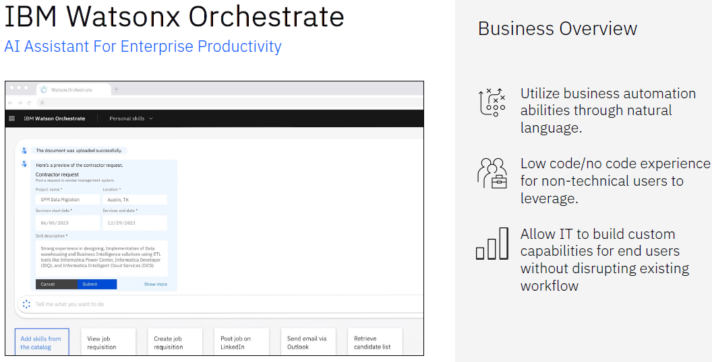

Slide 23
Pharmaceutical Reframing of Variables and Action Logic
In a pharmaceutical AI assistant, variables function as named containers that store crucial patient or treatment information, such as dosing schedules for medications like exenatide (marketed as Byetta) or pramlintide acetate (sold as Symlin). By referencing these variables by name, the assistant can retrieve or update information in real time, enhancing patient care. For instance, a variable called medication_dose might store the patient’s current dosage of Byetta, a value that can be accessed or modified based on treatment progress.
Action-Step Variables
When a step gathers information, such as asking about a patient's experience with Symlin, that data is automatically stored in an action-step variable. These variables function like short-term memory, existing only for the duration of the current interaction step. For example, a variable might store the patient’s response to a question about side effects during Step 1. These variables cannot be renamed and persist only while that specific step is active.
Session Variables
Sometimes, user input gathered in one step, like insulin levels for Byetta users, may need to be accessed in other parts of the session. This is where session variables come into play. They serve as long-term memory within the session, allowing the assistant to store patient details or treatment preferences for later use across multiple actions. For example, a session variable could store the patient's weight to adjust pramlintide acetate dosage recommendations, ensuring the correct information is available throughout the interaction. You can also define session variables based on other session variables, allowing complex calculations, such as calculating a patient’s next dose based on current blood sugar levels using Spring Expression Language (SpEL).
Assistant Variables
In addition to custom variables, the AI assistant has built-in assistant variables that can provide global information, such as the current time or date, useful for scheduling doses of Symlin or appointments with healthcare providers. These variables are automatically updated at runtime and can be used in various steps to offer precise, context-specific guidance.

Slide 24
Managing Conversation Flow
The default configuration of the assistant processes steps sequentially, like guiding a patient through understanding Byetta administration guidelines. However, the And then section allows for flexibility in the conversation flow based on user input. This capability makes it possible to create personalized pathways based on patient responses, such as adjusting Byetta dosage based on a user’s insulin level.
Where to Go at the End of a Step:
Continue to Next Step: This option moves the user to the next question, such as asking about another aspect of Symlin administration.

Slide 25
Re-ask Previous Step(s): If the patient makes a mistake when providing input, like incorrectly stating their dosage of exenatide, the assistant can revisit earlier steps, allowing them to correct the information before proceeding.
Go to a Subaction: This allows the assistant to branch off into another relevant action, such as collecting more detailed medical history before recommending a new treatment plan involving pramlintide acetate.
End the Action: This option terminates the conversation once all necessary information, such as confirming that the patient understands Byetta injection procedures, has been gathered. Multiple steps in an action can have their own designated end points, especially in cases where different branches address different treatments.
Testing and Debugging
Before deploying any changes, you can preview the assistant’s performance, ensuring that all interactions, such as dosage recommendations for Byetta or reminders about Symlin injection schedules, work smoothly.
The preview mode offers insights into why certain responses are triggered, enabling you to adjust the AI’s logic before it is deployed in a live healthcare setting.
In summary, integrating session and action-step variables into pharmaceutical AI assistants makes it possible to deliver tailored, responsive guidance to patients using medications like exenatide or pramlintide acetate.
These tools help improve patient care by ensuring that critical data, such as dosing schedules, side effects, and treatment progress, is readily accessible and used correctly.

Slide 26
Pharmaceutical Reframing of Debug Mode and AI Features
In the context of a pharmaceutical AI assistant guiding patients through their treatment journey—whether with dapagliflozin (marketed as Farxiga), acalabrutinib (sold as Calquence), or budesonide (available as Airsupra)—debug mode serves as a powerful tool to ensure smooth and accurate interactions. The system is equipped with four key tools to analyze actions during patient engagement:
1. Start and End of an Action
The assistant marks key points when a patient interacts, such as confirming a Farxiga dosage or asking about potential side effects of Airsupra. It tracks when an action begins and how it ends, offering multiple completion options:
With an end step: Perhaps finishing a treatment plan overview for Calquence.
Without an end step: When more information is needed, such as clarifying whether the patient requires a follow-up for dapagliflozin.
With human agent escalation: In complex cases where a medical professional is required.
With a knowledge base search: For queries that can be resolved with self-help resources, like instructions on administering budesonide.
2. Action Confidence Score
When the AI assistant interprets patient input, such as inquiring about adjusting Farxiga doses, each entry is assigned a confidence score. Hovering over the confidence icon reveals which action is most likely to match the patient's query.
For example, the assistant might prioritize steps involving the correct usage of Calquence if it scores highest. If no action surpasses 20% confidence, the assistant defaults to "No action matches," which could prompt the AI to ask clarifying questions, ensuring accurate patient guidance.

Slide 27
3. Step Locator
In pharmaceutical applications, sometimes errors occur during patient guidance, like during a step addressing the administration of Airsupra. A step locator helps you pinpoint where the issue occurred in the process. Clicking on the locator icon immediately shows the corresponding step in the editor, allowing you to quickly correct issues without disrupting the patient's care pathway.
4. Follow Along
The Follow Along feature syncs the Preview tool with your assistant’s backend, ensuring that as patients navigate through different stages of care, like adjusting dapagliflozin doses or inquiring about the side effects of acalabrutinib, the corresponding step in the background opens automatically.
This allows for real-time adjustments if a step in the assistant misinterprets input or provides incorrect information.
Testing Variables
As you test the conversation, it's essential to check that the AI assistant correctly sets variables related to treatment regimens. For example, confirming that a medication_dose variable for Farxiga or Calquence reflects accurate patient data is critical.
The variable values window provides a breakdown of action and session variables, ensuring that personalized treatment information is managed efficiently.
AI Features in watsonx Orchestrate Assistant Builder
The system offers several advanced AI capabilities, crucial for pharmaceutical applications where patient safety is paramount:
Clarifying Questions and Topic Change: Disambiguation is used when the assistant, for example, is unsure whether the patient is referring to budesonide or acalabrutinib when asking about side effects. By asking clarifying questions, the AI avoids dead ends or incorrect treatment recommendations, ensuring accurate guidance.
Confidence Scoring: Behind the scenes, the AI assigns absolute confidence scores based on input relevance. For instance, if a patient asks about the efficacy of Farxiga in reducing heart failure risk, the system calculates whether the input matches built-in steps regarding dapagliflozin. If no score surpasses 20%, the assistant won’t trigger an action, instead asking for further clarification.

Slide 28
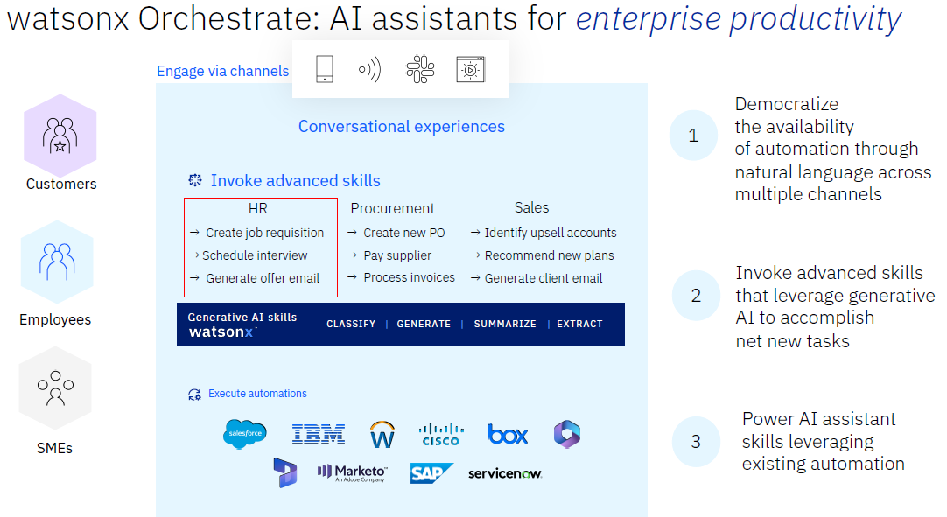

Slide 29
Out of the box AI and Topic Change (Digression): In real conversations, patients may get sidetracked, asking questions about other medications like Calquence while discussing Airsupra.
The assistant can handle such digressions smoothly, guiding the patient back to the original topic or addressing the new one, depending on the situation.
In summary, the integration of AI tools like debug mode, confidence scoring, and clarifying questions ensures that pharmaceutical assistants provide accurate, reliable, and personalized guidance to patients using medications such as Farxiga, Airsupra, and Calquence.
These features streamline patient interactions, ensuring seamless care management while minimizing errors.
Pharmaceutical Reframing of Conversation Topic Change and Web Chat Integration
In the context of guiding patients through treatment with medications like sodium zirconium cyclosilicate (marketed as Lokelma), olaparib (available as Lynparza), or osimertinib (sold as Tagrisso), the ability to change conversation topics dynamically is essential for ensuring patient understanding and support.
How Changing the Topic Works
For example, when guiding a patient through the administration of Lokelma to treat hyperkalemia, the assistant might ask, "What is your current potassium level?"
If the patient doesn’t know what a potassium level is, the assistant can recognize the need to switch to an explanation of this term.
Once the new topic is addressed, the assistant will return to the original action such as confirming the dosage of Lokelma.

Slide 30
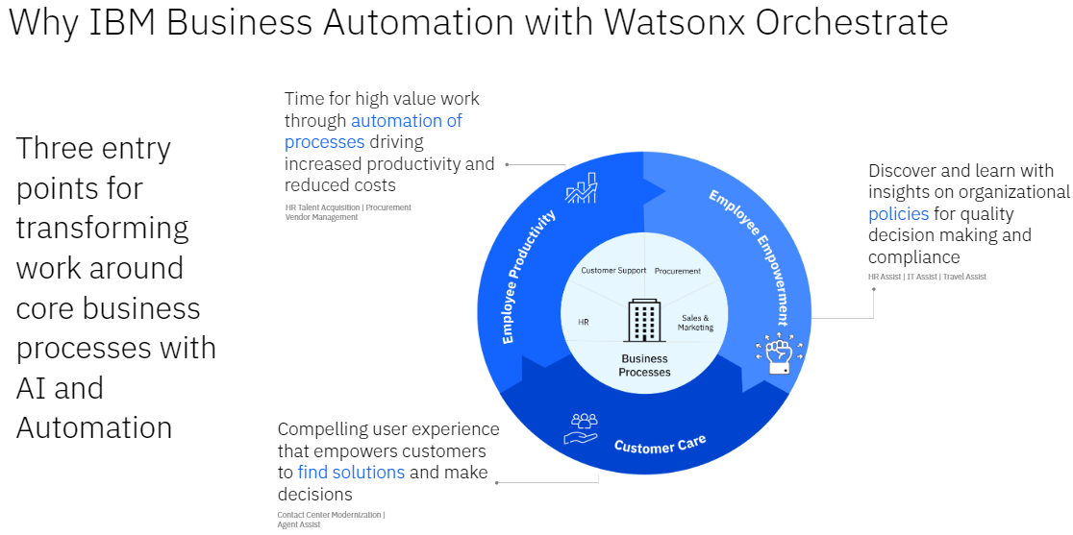

Slide 31
The assistant determines when to change the topic based on these criteria:
Response Validation: After the patient responds, such as providing lab results while managing Tagrisso (osimertinib) treatment for lung cancer, the assistant first checks if the input matches the expected data type, like a numeric potassium level.
Input Recognition: If the input doesn’t fit, such as asking "What are the side effects of Lynparza?" while discussing a blood test, the assistant evaluates if this matches another action.
If the input scores 20% or higher in confidence, the assistant switches to the new action.
Action Continuation: Once the secondary action completes, the assistant asks if the patient wishes to return to the original query, like resuming dosage guidance for Lokelma. If yes, the assistant continues where it left off.
However, if the input doesn’t match the expected format, such as a non-numeric value where a lab result is expected, a validation error occurs.
Additionally, if a topic switch occurs while an action, like reviewing side effects for Lynparza, is in progress, the switch to another topic may not be available until that step is complete.

Slide 32
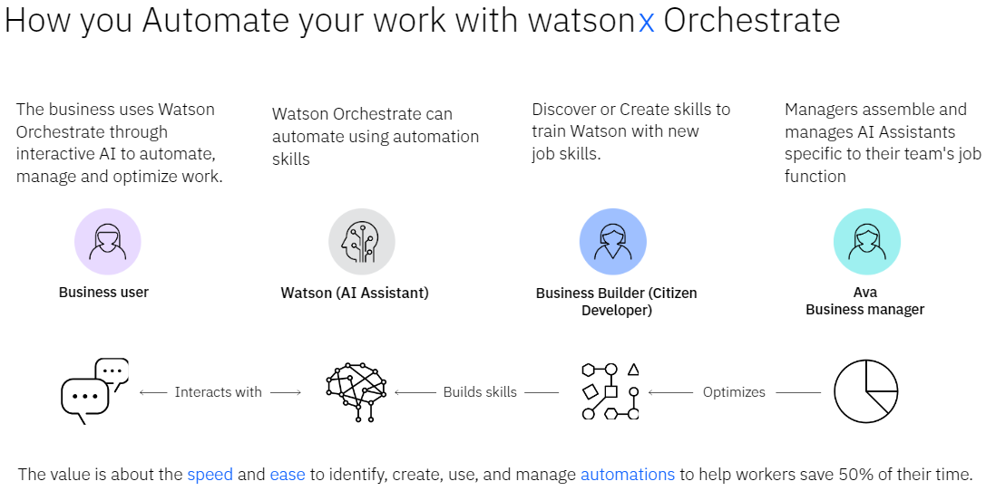

Slide 33
Best Practices for Handling Topic Changes
Patients often change topics mid-conversation, such as switching from discussing osimertinib side effects to asking about the use of Lokelma in treating hyperkalemia.
To address these topic shifts, assistants are designed with several actions covering related queries, ensuring smooth patient support throughout their treatment journey.
Enabling and Disabling Topic Change
By default, the ability to change conversation topics is enabled for all interactions. You can disable it globally or for specific actions, allowing tighter control over how the assistant navigates patient queries related to medications like Lynparza or Tagrisso.
Web Chat Integration for Patient Support
Deploying a pharmaceutical AI assistant on your website, whether to support patients using Lokelma or providing guidance on Lynparza, is simplified through web chat integration.
This chat feature allows seamless patient interaction, answering common questions about medications or offering personalized treatment guidance.
Why Use Web Chat?
Building a custom user interface (UI) for patient assistance, such as navigating the treatment plans for Tagrisso, can be time-consuming. By using the ready-made web chat, you avoid issues like designing layouts, managing browser compatibility, and ensuring accessibility. Instead, you can focus on refining the assistant’s ability to provide accurate medication guidance.
What Can You Do with Web Chat?
You can quickly deploy web chat on your pharmaceutical website to guide patients through using medications like Lokelma or osimertinib. The chat interface allows multimedia elements like forms, dosage schedules, and interactive guidance to streamline patient interactions.

Slide 34
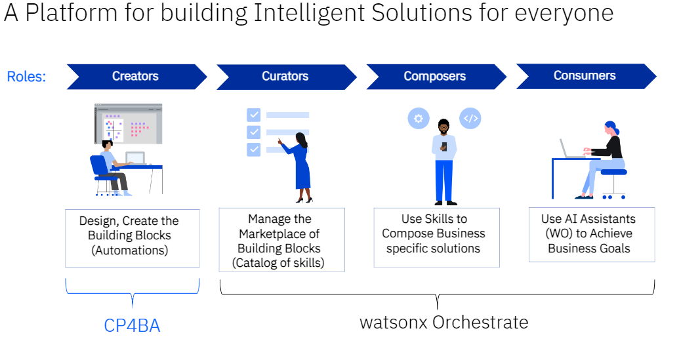

Slide 35
Publishing the Assistant
Once your assistant, equipped to handle queries on medications like Lynparza or Tagrisso, is ready, you can publish incremental versions for live use.
Each published version, like V1 or V2, captures a snapshot of the assistant’s capabilities, ensuring that your assistant evolves with new patient needs.
Embedding the Web Chat on Your Website
To integrate your pharmaceutical assistant on your site:
Copy the script generated in the Web chat channel of the Assistant builder.
Paste it into your website’s HTML before the closing </head> tag.
Save and deploy the code.
This simple process embeds an AI-powered assistant, enabling patients to interact with a virtual guide for their treatment with medications like Lokelma, Lynparza, or Tagrisso, helping them navigate their healthcare journey smoothly and efficiently.
Reference
https://research.ibm.com/projects/biomedical-foundation-models#publications

Slide 36
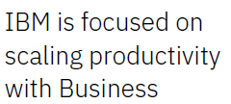
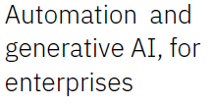
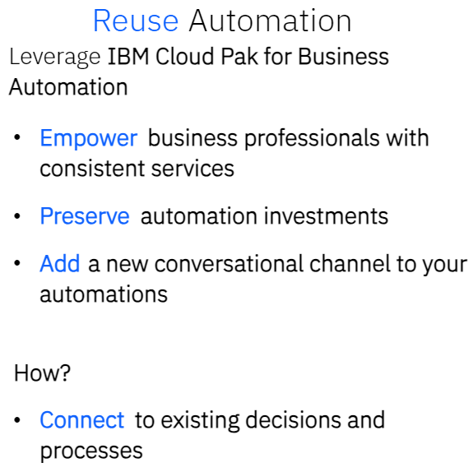
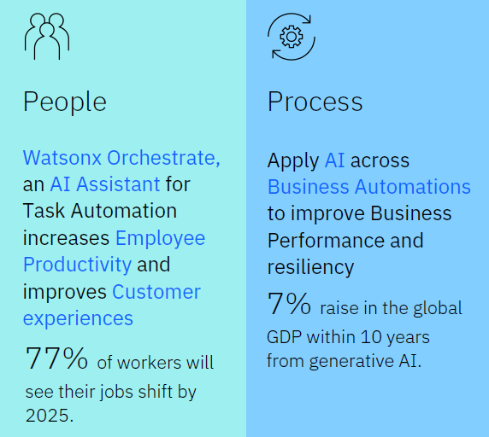

Slide 37
